Slide 1
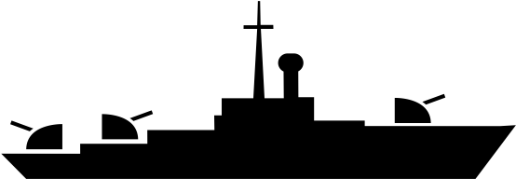
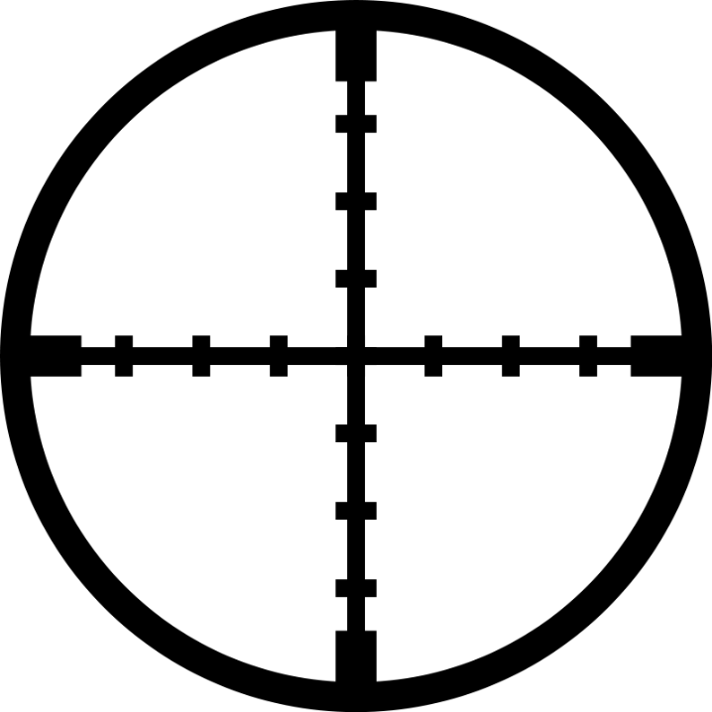
Missouri
Missouri
Start

Slide 2
Mode Selection
Single Player
1 v 1

Slide 3
Choose Difficulty Level
Easy
Hard

Slide 4
Easy Mode
1 2 3 4 5 6 7 8 9 10
A
B
C
D
E
F
G
H
I
v
x 1
v
x 2
v
x 3
Space bar
v
x 4
Enter
Deployed vessels: 0
Ships will appear on the board in descending order according
to their size. All ships should be deployed in the grid.

Slide 5
Hard Mode
1 2 3 4 5 6 7 8 9 10
A
B
C
D
E
F
G
H
I
v
x 1
v
x 2
v
x 3
Space bar
v
x 4
Enter
Deployed vessels: 0
Ships will appear on the board in descending order according
to their size. Placement of ships on black blocks (reefs) are not allowed!
All ships should be deployed in the grid.

Slide 6
Hard Mode
1 2 3 4 5 6 7 8 9 10
A
B
C
D
E
F
G
H
I
v
x 1
Message 02
v
x 2
v
x 3
Please don‘t put the ship in black area.
Space bar
v
x 4
ok
Enter
Deployed vessels: 0
Ships will appear on the board in descending order according
to their size. Placement of ships on black blocks (reefs) are not allowed!
All ships should be deployed in the grid.

Slide 7
1 2 3 4 5 6 7 8 9 10
A
B
C
D
E
F
G
H
I
v
x 1
v
x 2
v
x 3
Space bar
v
x 4
Enter
Deployed vessels: 0
Ships will appear on the board in descending order according
to their size. All ships should be deployed in the grid.

Slide 8
1 2 3 4 5 6 7 8 9 10
A
B
C
D
E
F
G
H
I
v
x 1
Message 01
v
x 2
v
x 3
Please don‘t overlap the vessels.
Space bar
v
x 4
ok
Enter
Deployed vessels: 0
Ships will appear on the board in descending order according
to their size. All ships should be deployed in the grid.

Slide 9

1 2 3 4 5 6 7 8 9 10
1 2 3 4 5 6 7 8 9 10
A
B
C
D
E
F
G
H
I
A
B
C
D
E
F
G
H
I
VS.
Attack
Quit

Slide 10
1 2 3 4 5 6 7 8 9 10
1 2 3 4 5 6 7 8 9 10
A
B
C
D
E
F
G
H
I
A
B
C
D
E
F
G
H
I
Message 03
Are you sure you want to quit the game?
Yes
No
Attack
Quit

Slide 11
Result :
Home Page
Exit

